Slide 1
An Introduction to Scrummy
Presented by
Dinesh Gonuguntla
Kamile Forbes
Zach Schaefer

Slide 2
Scrummy in 100 words
Scrummy is an agile process based on Scrum that allows us to focus on delivering the highest business value in the shortest time.
It allows us to rapidly and repeatedly inspect actual working software (every one week to one month).
The business sets the priorities. Teams self-organize to determine the best way to deliver the highest priority features.
Every week or two (sometimes longer), anyone can see real working software and decide to release it as is or continue to enhance it for another sprint.

Slide 3
Scrum has been used for:
Commercial software
In-house development
Contract development
Fixed-price projects
Financial applications
ISO 9001-certified applications
Embedded systems
24x7 systems with 99.999% uptime requirements
the Joint Strike Fighter
Video game development
FDA-approved, life-critical systems
Satellite-control software
Websites
Handheld software
Mobile phones
Network switching applications
ISV applications
Some of the largest applications in use

Slide 4
Characteristics of Scrummy
Self-organizing teams
Product progresses in a series of “sprints” of varying lengths
Requirements are captured as items in a list of “product backlog”
No specific engineering practices prescribed
Uses generative rules to create an agile environment for delivering projects
One of the “agile processes”

Slide 5


The Agile Manifesto–a statement of values
Individuals and interactions
Process and tools
over
Working software
Comprehensive documentation
over
Customer collaboration
Contract negotiation
over
Responding to change
Following a plan
over

Slide 6





Scrummy
24 hours
Sprint
1-4 weeks
Sprint goal
Return
Sprint backlog
Potentially shippable
product increment
Return
Cancel
Coupons
Gift wrap
Gift wrap
Coupons
Cancel
Product
backlog

Slide 7
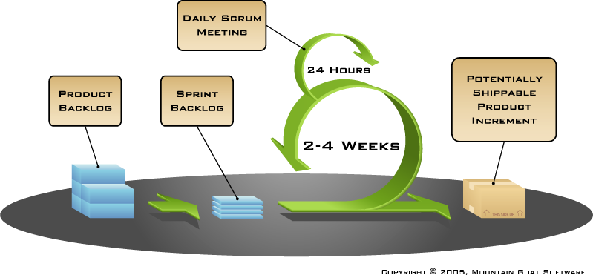
Putting it all together

Slide 8
Sprints
Scrummy projects make progress in a series of “sprints”
Analogous to Extreme Programming iterations
Typical duration is 1–4 weeks or a calendar month at most
A constant duration leads to a better rhythm
Product is designed, coded, and tested during the sprint

Slide 9

Sequential vs. overlapping development
Requirements
Design
Code
Test
Rather than doing all of one thing at a time...
...Scrummy teams do a little of everything all the time

Slide 10

No changes during a sprint
Plan sprint durations around how long you can commit to keeping change out of the sprint

Slide 11
Scrummy framework
Roles
Product owner
ScrumMaster
Team
Ceremonies
Sprint planning
Sprint review
Sprint retrospective
Daily scrum meeting
Artifacts
Product backlog
Sprint backlog
Burndown charts

Slide 12
Scrum framework
Roles
Product owner
ScrumMaster
Team
Ceremonies
Sprint planning
Sprint review
Sprint retrospective
Daily scrum meeting
Artifacts
Product backlog
Sprint backlog
Burndown charts

Slide 13

Product owner
Define the features of the product
Decide on release date and content
Be responsible for the profitability of the product (ROI)
Prioritize features according to market value
Adjust features and priority every iteration, as needed
Accept or reject work results

Slide 14

The Scrum Master
Represents management to the project
Responsible for enacting Scrum values and practices
Removes impediments
Ensure that the team is fully functional and productive
Enable close cooperation across all roles and functions
Shield the team from external interferences

Slide 15





The team
Typically 5-9 people
Cross-functional:
Programmers, testers, user experience designers, etc.
Members should be full-time
May be exceptions (e.g., database administrator)

Slide 16
The team
Teams are self-organizing
Ideally, no titles but rarely a possibility
Membership should change only between sprints

Slide 17
Scrum framework
Roles
Product owner
ScrumMaster
Team
Ceremonies
Sprint planning
Sprint review
Sprint retrospective
Daily scrum meeting
Artifacts
Product backlog
Sprint backlog
Burndown charts

Slide 18


Team capacity
Sprint planning meeting
Sprint prioritization
Product backlog
Sprint
goal
Analyze and evaluate product backlog
Select sprint goal
Business conditions
Sprint planning
Decide how to achieve sprint goal (design)
Create sprint backlog (tasks) from product backlog items (user stories / features)
Estimate sprint backlog in hours
Current product
Sprint
backlog
Technology

Slide 19

Sprint planning
Team selects items from the product backlog they can commit to completing
Sprint backlog is created
Tasks are identified and each is estimated (1-16 hours)
Collaboratively, not done alone by the ScrumMaster
High-level design is considered
As a vacation planner, I want to see photos of the hotels.
Code the middle tier (8 hours)
Code the user interface (4)
Write test fixtures (4)
Code the foo class (6)
Update performance tests (4)

Slide 20
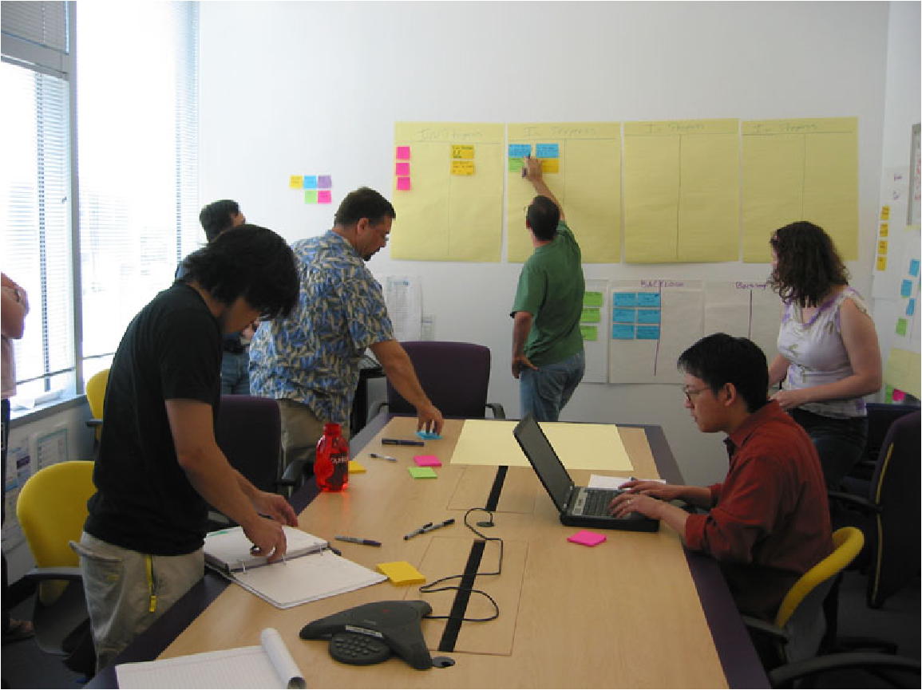
The daily scrum
Parameters
Daily
>30 to <60-minutes
Stand-up
Not for problem solving
Whole world is invited
Only team members, Scrum Master, product owner, can talk
Helps avoid other unnecessary meetings

Slide 21

Everyone answers 3 questions
1
What did you do yesterday?
2
What will you do today?
3
Is anything in your way?
These are not status for the ScrumMaster
They are commitments in front of peers

Slide 22
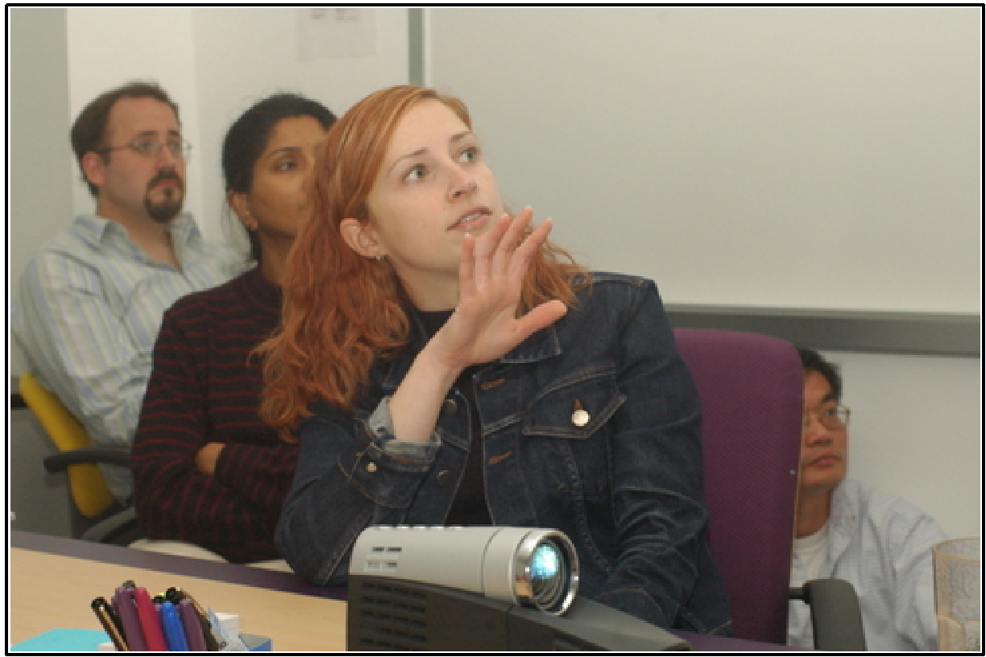
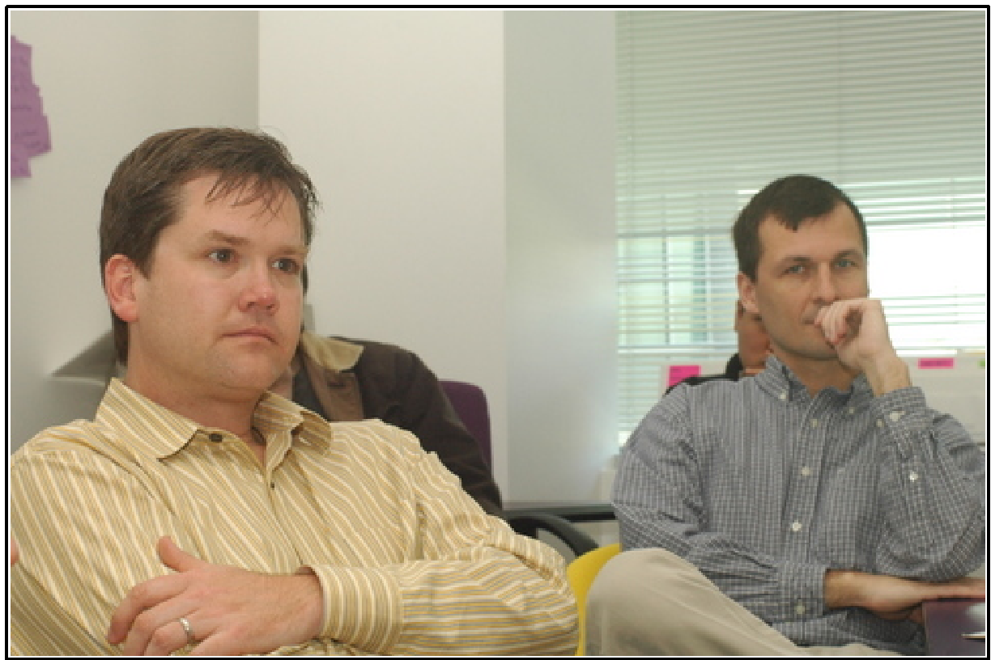
The sprint review
Team presents what it accomplished during the sprint
Typically takes the form of a demo of new features or underlying architecture
Informal
2-hour prep time rule
No slides
Whole team participates
Invite the world

Slide 23
Sprint retrospective
Periodically take a look at what is and is not working
Typically 15–30 minutes
Done after every sprint
Whole team participates
Scrum Master
Product owner
Team
Possibly customers and others

Slide 24

Start / Stop / Continue
Whole team gathers and discusses what they’d like to:
Start doing
Stop doing
This is just one of many ways to do a sprint retrospective.
Continue doing

Slide 25
Scrummy framework
Roles
Product owner
ScrumMaster
Team
Ceremonies
Sprint planning
Sprint review
Sprint retrospective
Daily scrum meeting
Artifacts
Product backlog
Sprint backlog
Burndown charts

Slide 26

Product backlog
The requirements
A list of all desired work on the project
Ideally expressed such that each item has value to the users or customers of the product
Prioritized by the product owner
Reprioritized at the start of each sprint
This is the product backlog

Slide 27
A sample product backlog
Backlog item | Estimate
Allow a guest to make a reservation | 3
As a guest, I want to cancel a reservation. | 5
As a guest, I want to change the dates of a reservation. | 3
As a hotel employee, I can run RevPAR reports (revenue-per-available-room) | 8
Improve exception handling | 8
... | 30
... | 50

Slide 28
The sprint goal
A short statement of what the work will be focused on during the sprint
Life Sciences
Support features necessary for population genetics studies.
Database Application
Make the application run on SQL Server in addition to Oracle.
Financial services
Support more technical indicators than company ABC with real-time, streaming data.

Slide 29
Managing the sprint backlog
Individuals sign up for work of their own choosing
Work is never assigned
Estimated work remaining is updated daily

Slide 30
Managing the sprint backlog
Any team member can add, delete or change the sprint backlog
Work for the sprint emerges
If work is unclear, define a sprint backlog item with a larger amount of time and break it down later
Update work remaining as more becomes known

Slide 31
A sprint backlog
Tasks
Mon
Tues
Wed
Thur
Fri
Code the user interface
8
4
8
Code the middle tier
16
12
10
4
Test the middle tier
8
16
16
11
8
Write online help
12
Write the foo class
8
8
8
8
8
Add error logging
8
4

Slide 32
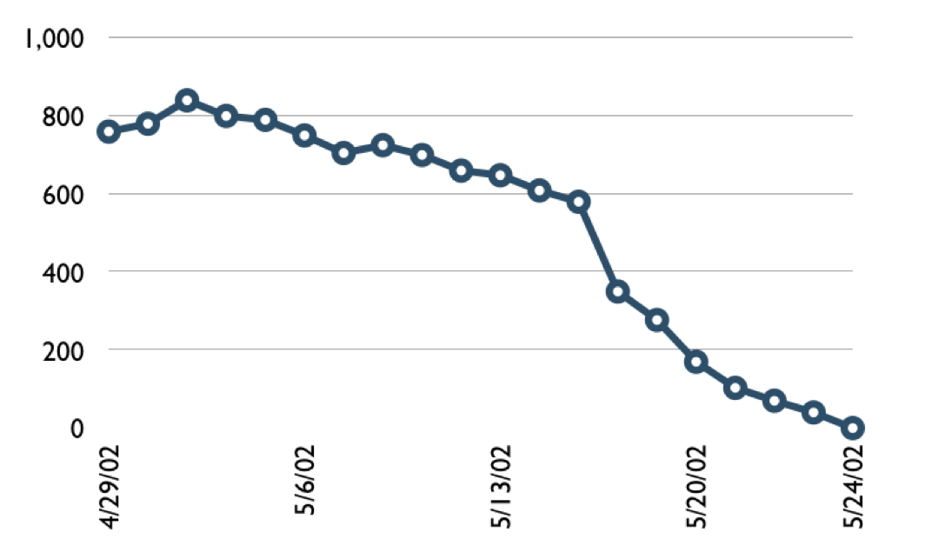

A sprint burndown chart
Hours

Slide 33
Tasks
Mon
Tues
Wed
Thur
Fri
Code the user interface
8
4
8
Code the middle tier
16
12
10
7
Test the middle tier
8
16
16
11
8
Write online help
12
50
40
30
Hours
20
10
0
Mon
Tue
Wed
Thu
Fri

Slide 34
Scalability
Typical individual team is 7 ± 2 people
Scalability comes from teams of teams
Factors in scaling
Type of application
Team size
Team dispersion
Project duration
Scrum has been used on multiple 500+ person projects

Slide 35
Security Requirements
Robust security requirements ensures that software can only be used as intended
When building security requirements, be specific about the types of vulnerabilities they must prevent
It is always beneficial to build secure software

Slide 36
Building Security Requirements
When building security requirements, keep these questions in mind:
Is this testable?
Is this measurable?
Is this complete?
Is this clear?
Is this unambiguous?
Are these requirements consistent?

Slide 37
Building Security Requirements
When defining functionality in the early design phases, the functionality must be defined securely
Utilizing abuse cases will allow designers to analyze how functionality might be abused

Slide 38
Quality Assurance
A quality product meets the needs and expectations of customers with respect to:
Functionality
Design
Reliability
Durability
Price
Quality assurance provides a guarantee that the product will work and meet the expectations of the customer

Slide 39
The QA Process
Quality Assurance has a defined cycle called the PDCA cycle. The phases of this cycle are:
Plan - plan and establish process related objectives
Do - development and testing of processes
Check - monitoring and modifying of processes, check if product meets predetermined objectives
Act - implement actions that are necessary to achieve improvements in the processes

Slide 40
Quality Assurance Practices
Create a robust testing environment
Select release criteria carefully
Apply automated testing to high-risk areas
Allocate time appropriately for each process
Prioritize bug fixes based on software usage
Form dedicated security and performance testing team
Simulate customer accounts similar to a production environment

Slide 41
Quality Assurance Functions
There are five primary QA functions:
Technology transfer
Validation
Documentation
Assuring quality of products
Quality improvement plans

Slide 43



INTRODUCTION
Software testing is the process used to identify the correctness, completeness and quality of developed computer software.
It is the process of executing a program/application under positive and negative conditions by manual or automated means. It checks for the :-
Specification
Functionality
Performance

Slide 44

OBJECTIVES
Uncover as many as errors (or bugs) as possible in a given product.
Demonstrate a given software product matching its requirement
specifications.
Validate the quality of a software testing using the minimum cost
and efforts.
Generate high quality test cases, perform effective tests, and issue correct and helpful problem reports.

Slide 45
Error, Bug, Fault & Failure
Error : It is a human action that produces the incorrect result that produces a fault.
Bug : The presence of error at the time of execution of the software.
Fault : State of software caused by an error.
Failure : Deviation of the software from its expected result. It is an event.

Slide 46
SDLC(Software Development Life Cycle)
Standard model used word wide to develop a software.
A framework that describes the activities performed at each stage of a software development project.
Necessary to ensure the quality of the software.
Logical steps taken to develop a software product.

Slide 47
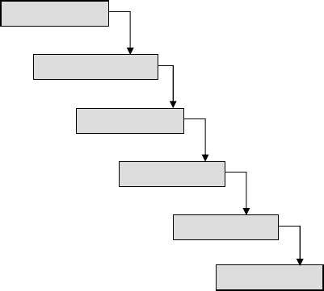
Classical Waterfall Model
Feasibility Study
Requirements Analysis & Specification
Design
Coding & Unit Testing
Integration & System Testing
Maintenance
It is the oldest and most widely used model in the field of software development.

Slide 48
Testing Life Cycle
Project Initiation
Summary Reports
System Study
Analysis
Test Plan
Regression Test
Design Test Cases
Report Defects
Execute Test Cases ( manual /automated )

Slide 49
Test Plan
It is a systematic approach to test a system i.e. software. The plan typically contains a detailed understanding of what the eventual testing workflow will be.

Slide 50
Test Case
It is a specific procedure of testing a particular requirement.
It will include:
Identification of specific requirement tested Test case success/failure criteria
Specific steps to execute test
Test data

Slide 51
Verification vs Validation
Verification: The software should confirm to its specification (Are we building the product right?)
Validation: The software should do what the user really requires (Are we building the right product?)

Slide 52





Testing Methodologies
Black box testing
White box testing

Slide 53
Black box testing
No knowledge of internal program design or code required.
Tests are based on requirements and functionality.
White box testing
Knowledge of the internal program design and code required.
Tests are based on coverage of code statements, branches, paths, conditions.

Slide 54




Black box testing
requirements
output
input
events

Slide 55



White box testing
Test data
Tests
Derives
Component code
Test outputs

Slide 56
Testing Levels
Unit testing
Integration testing
System testing

Slide 57
UNIT TESTING
Tests each module individually.
Follows a white box testing (Logic of the program). Done by developers.

Slide 58
INTEGRATION TESTING
Once all the modules have been unit tested, integration testing is performed.
It is systematic testing.
Produce tests to identify errors associated with interfacing.
Types:
Big Bang Integration testing Top Down Integration testing Bottom Up Integration testing Mixed Integration testing

Slide 59

SYSTEM TESTING
The system as a whole is tested to uncover requirement errors.
Verifies that all system elements work properly and that overall system function and performance has been achieved.
Types:
Alpha Testing Beta Testing
Acceptance Testing Performance Testing

Slide 60
Alpha Testing
It is carried out by the test team within the developing organization .
Beta Testing
It is performed by a selected group of friendly customers.
Acceptance Testing
It is performed by the customer to determine whether to accept or reject the delivery of the system.
Performance Testing
It is carried out to check whether the system meets the nonfunctional requirements identified in the SRS document.

Slide 61
Types of Performance Testing:
Stress Testing
Volume Testing
Configuration Testing
Compatibility Testing
Regression Testing
Recovery Testing
Maintenance Testing
Documentation Testing
Usability Testing

Slide 62
DISCUSSION
In order to be cost effective, the testing must be concentrated on areas where it will be most effective.
The testing should be planned such that when testing is stopped for whatever reason, the most effective testing in the time allotted has already been done.
The absence of an organizational testing policy may result in too much effort and money will be spent on testing, attempting to achieve a level of quality that is impossible or unnecessary.

Slide 63
THANK YOU

